Slide 1
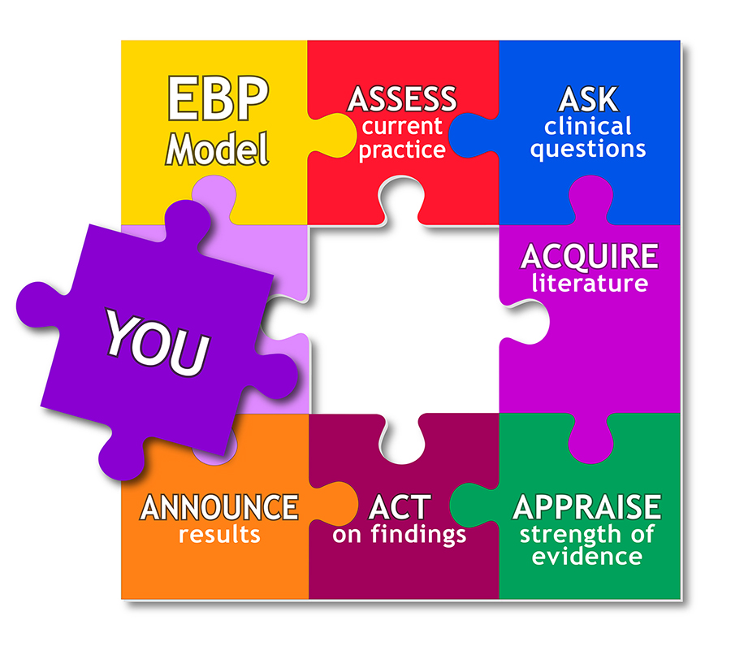
Evidence Based Approaches
Week 1- Slide 2
Evidence based Approaches

Slide 2
Module lecturer-Tayo Alebiosu
Health and Social Care
Evidence Based Approaches
Contact me: tayo.alebiosu@lsclondon.co.uk

Slide 3

Aim;
Explain the role of research for evidence-based practice in health and social care
Learning outcomes At the end of this lesson students will be able to ;
1-Explain the purpose of evidence-based practice
2-Describe the ability of EBP to gain access to new ideas and thinking in finding solutions to health care problems.

Slide 4
Introduction
In health and social care, research is conducted for a number of reasons for example, to find prevalence or incidence of disease, to assess quality of life or patient satisfaction.
Research has global relevance and plays a significant role in influencing the development of high-quality provision, supporting a high-functioning integrated workforce and promoting the health and wellbeing of those who use health, care services.

Slide 5

Starter activity
What is research?
Why do we need research?
10 minutes

Slide 6
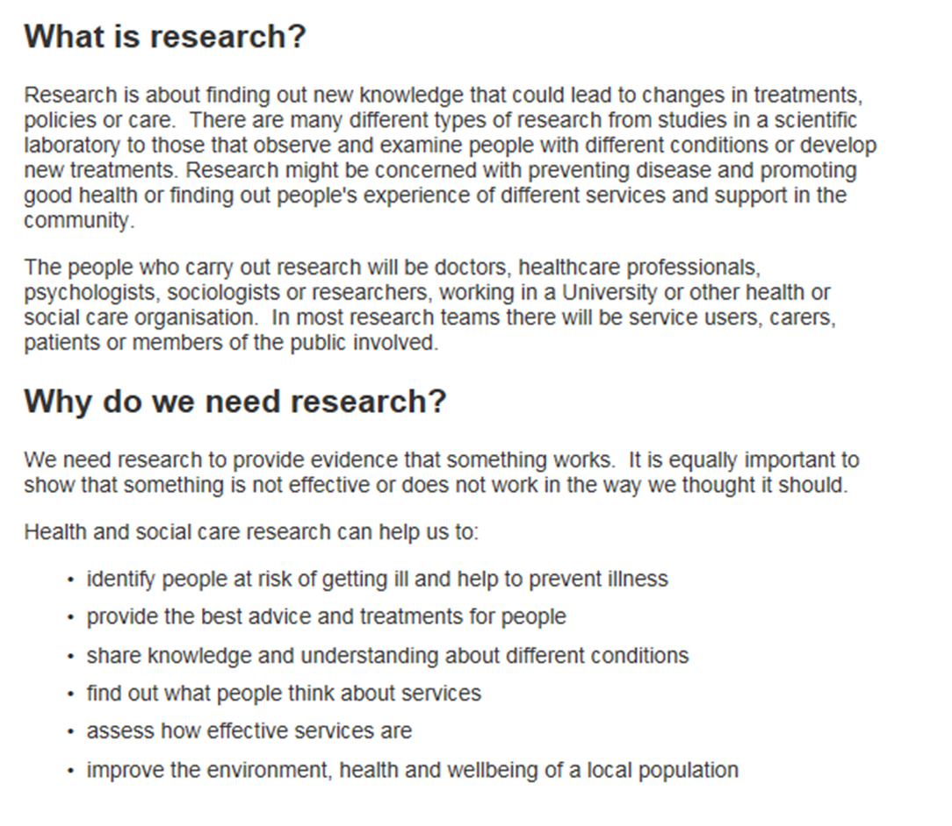

Slide 7

Research?
Research is a term used for any kind of investigation that is intended to uncover interesting or new facts
Research methods are the techniques used to do research
Why do we conduct research?
What method of research do you carry out everyday?
What is the process you follow?

Slide 8
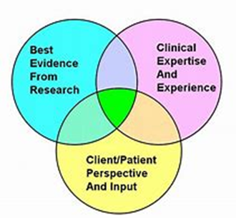
Research….cont.
Research refers to a search for knowledge
Research means a scientific and systematic search for pertinent information on a specific topic
In fact, research is an art of scientific investigation.
The purpose of research is to discover answers to questions through the application of scientific procedures.

Slide 9
How research changed my life:
https://youtu.be/nrE1N7VaXJA
Audio file: Sultan Ali is 13 and from Birmingham. Sultan has Morquio syndrome. Listen to him explain how being part of a clinical research trial has changed his life.
Morquio syndrome is a rare genetic condition that affects a child's bones and spine, organs and physical abilities. Children with this condition are missing or don't produce enough of the enzymes that break down sugar chains naturally produced in the body.

Slide 10
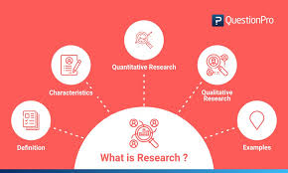

Slide 11
How research develops, improves or identifies gaps in practice and/or provision
During research, you may find issues that you need to fix.
Improving practice is about trying to stop further tragedy’s from happening such as the Baby P case
An example of improving practice in health and social care is if a hospital exposed institutional abuse, here they would research into what had happened and how they could prevent it and highlights where services are going wrong and where improvements can be made

Slide 12
Table 1 What research can do
Purpose | `Types of research study' | Example
Describe the current situation | Descriptive studies (surveys of people or practice) | How many young people start to smoke while at school
Look for an explanation for current behaviour | Qualitative research (Interviews/surveys) | Why many elderly people are reluctant to seek help
Test a hypothesis based on a prediction | Quantitative research (Clinical trials and laboratory-based studies) | That massage is more effective than single-remedy treatments for back pain.
Seek generalisations | Multi-centre trials and systematic reviews of controlled trials | Is nicotine replacement therapy better than willpower alone to stop smoking
Source: RCCM [Online]

Slide 13
Research Evidence (Source)
Arising from well conducted and reviewed research studies, ideally conducted in clinical areas.
Published in peer reviewed journals and other sources (Cochrane library) and thus exposed to external/expert scrutiny
Clinical expertise and the user voice may be present in published research e.g. through action research or qualitative studies of user experience
‘..there has been anxiety that the emphasis on evidence ignores practitioner’s skills and individual patient preferences…’ (Closs and Cheater (1999).

Slide 14
Activity 1
Pair activity: Students identify areas of research in their own daily practice to illustrate the way they unconsciously conduct research in personal and work lives.
Examples
Physical and/or mental health and wellbeing, e.g. safety or
safeguarding/protection considerations

Slide 15


10 minutes break

Slide 16


Now…lets look at Evidence based Approach

Slide 17
LO1 Video activity
Individually,
From the video clip explain your understanding of evidence based approach in healthcare practice
Feedback to the group
10 minutes
https://youtu.be/j5sU5H-IBSg
This video provides an overview of evidence-based practice and the role of information in guiding decisions

Slide 18
Now….What is evidence-based practice?
A lifelong problem-solving approach to clinical care that integrates:
A systematic search for and critical appraisal of the most relevant and best research to answer clinical questions
One’s own clinical expertise (the proficiency and judgment that individual clinicians acquire through clinical experience and clinical practice)
Patients preferences and values

Slide 19
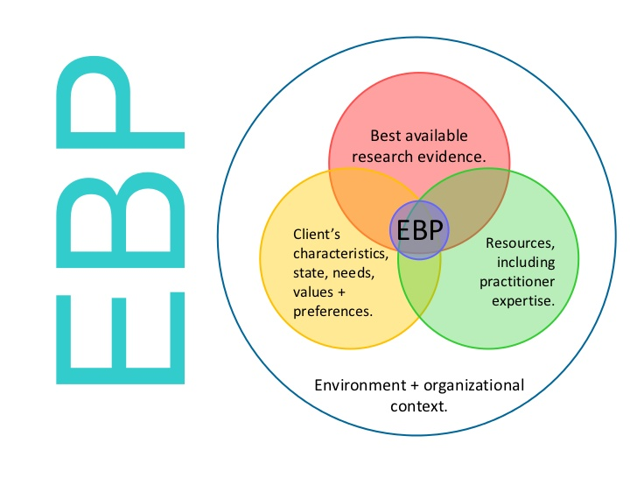
What is evidence-based practice?
EBP is practice supported by a clear, up-to-date rationale taking into account the patients/clients preferences and using your own judgement.
Decisions about HSC are based on the best available, current, valid and relevant evidence.
What are the consequences of using a ‘non-evidence based’ approach?
“The conscientious and judicious use of current best evidence in conjunction with clinical expertise and patient values to guide health (and social) care decisions.”
(Sackett et al, 2000)
10 Minutes

Slide 20
EBA
An EBP approach requires that we ensure our rationale is not only clear but also up-to-date and based on the best available evidence.
You need to be able to defend your practice and have a good rationale for the actions you have taken.
Research studies are the best evidence for your practice – why?
Or a review of all research studies carried out in that area.
EBP alone is not enough, you need the judgement of the practitioner and wishes of the patient.
https://www.bing.com/videos/search?q=evidence+based+practice+in+health&&view=detail&mid=B40B228DE6130896C17BB40B228DE6130896C17B&&FORM=VRDGAR

Slide 21
Evidence-based practice is…
EBP is practice supported by a clear, up-to-date rationale taking into account the patients/clients preferences and using your own judgement.
Decisions about HSC are based on the best available, current, valid and relevant evidence.
What are the consequences of using a ‘non-evidence based’ approach?
“The conscientious and judicious use of current best evidence in conjunction with clinical expertise and patient values to guide health (and social) care decisions.”
(Sackett et al, 2000)

Slide 22
Why is evidence-based practice important in Health and Social Care?
Uses current knowledge and evidence, theoretical and practical, provides robust answers to health issues and improves services.
Improves patient outcomes – increase patient safety, improve clinical outcomes and reduces health care costs
Reliable and valid
Consistency across the delivery of services
Trained staff
Patients trust in staff and treatment is increased
Treatment options are up to date
Staff have more knowledge
Avoids errors in practice

Slide 23
What are the benefits of evidence-based practice as a method in carrying out research?
Benefits of EBP to patients, staff and organisations
EBP gives us: (explain and give an example)
Access to new ideas and thinking
Finds solutions
Opportunities to develop practice
Service provision is better and up to date
Integrated workforce
Influence's policy
Identify future priorities

Slide 24
Why Evidence-Based Practice (EBP) ??
Health care delivery is filled with uncertainty and many questions arise in everyday practice…
What kind of guidance would be most helpful to my patients?
What clinical assessments and interventions are of the most benefit?

Slide 25
https://youtu.be/WiSklIGUblo
A look at some of the principles of critical thinking.

Slide 26
To effectively apply the EBP process;
Evidence Based Practice process in Health and Social Care?
Evidence-based practice is the process of applying existing research findings that has shown to work when considering a chosen strategy
To effectively apply the EBP process, in addition to the basic skills required to undertake nursing work, a nurse must have the ability to:
(1) Identify knowledge gaps,
(2) Formulate relevant questions,
(3) conduct an efficient literature search,
(4) Apply rules of evidence to determine the validity of studies,
(5) Apply the literature findings appropriately to the patient's problem,
(6) Appropriately involve the patient in the clinical decision making

Slide 27
Common questions that arise in everyday practice:
Which combination and sequence of treatments is most effective?
Which patient symptoms predict better or worse outcomes?
What is the experience of illness for a patient with this diagnosis?
Which treatment is most effective and will produce the best patient outcome?
If a diagnosis is left untreated, what might be the outcome?

Slide 28
How to do evidence based practice
The idea behind evidence-based practice is to ensure all healthcare is backed by firmly grounded evidence that includes the needs and preferences of individual patients (Carrier, 2009).
It means integrating individual clinical expertise with the best available external clinical evidence from systematic research.

Slide 29
What are the benefits of evidence-based practice as a method in carrying out research?
Benefits of EBP to patients, staff and organisations
EBP gives us: (explain and give an example)
Access to new ideas and thinking
Finds solutions
Opportunities to develop practice
Service provision is better and up to date
Integrated workforce
Influence's policy
Identify future priorities

Slide 30
Why is evidence-based practice important in Health and Social Care?
Uses current knowledge and evidence, theoretical and practical, provides robust answers to health issues and improves services.
Improves patient outcomes – increase patient safety, improve clinical outcomes and reduces health care costs
Reliable and valid
Consistency across the delivery of services
Trained staff
Patients trust in staff and treatment is increased
Treatment options are up to date
Staff have more knowledge
Avoids errors in practice

Slide 31
How to do evidence based practice?
The idea behind evidence-based practice is to ensure all healthcare is backed by firmly grounded evidence that includes the needs and preferences of individual patients (Carrier, 2009).
It means integrating individual clinical expertise with the best available external clinical evidence from systematic research.

Slide 32
To effectively apply the EBP process;
Evidence Based Practice process in Health and Social Care?
Evidence-based practice is the process of applying existing research findings that has shown to work when considering a chosen strategy
To effectively apply the EBP process, in addition to the basic skills required to undertake nursing work, a nurse must have the ability to:
(1) Identify knowledge gaps,
(2) Formulate relevant questions,
(3) conduct an efficient literature search,
(4) Apply rules of evidence to determine the validity of studies,
(5) Apply the literature findings appropriately to the patient's problem,
(6) Appropriately involve the patient in the clinical decision making

Slide 33
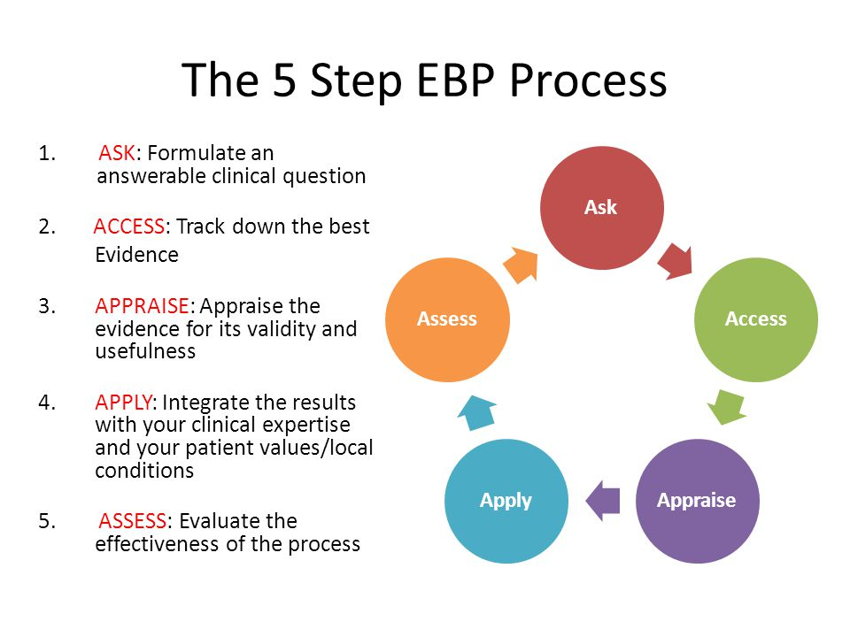
Process of conducting evidence-based practice in Health and Social Care?

Slide 34
Research Evidence (Source)
Arising from well conducted and reviewed research studies, ideally conducted in clinical areas.
Published in peer reviewed journals and other sources (Cochrane library) and thus exposed to external/expert scrutiny
Clinical expertise and the user voice may be present in published research e.g. through action research or qualitative studies of user experience
‘..there has been anxiety that the emphasis on evidence ignores practitioner’s skills and individual patient preferences…’ (Closs and Cheater (1999).

Slide 35

Portfolio activity
Individually using the worksheet,
Explain and give examples of the benefits of EBP to patients, Practitioners and organisation.
EBA-WEEK 1- PORTFOLIO ACTIVITY
STUDENT NAME …………………………………….
GROUP…………………………………………………
What are the benefits of evidence-based practice as a method in carrying out research?
Benefits of EBP to patients, Practitioners and organisations
EBP gives us: (explain and give an example)
Patients | Practitioners | Organisation

Slide 36
Advantages EBP
(Ross, 2012)
Patients | Practitioners | Organisation
Reduces the amount of time wasted on inappropriate care options Increased consistency as all patients receive the same level of care Increased confidence in practitioners as their knowledge of options is transparent Increased value for money Reduced variation of services Evidence can be used to support the need for additional resources | Professional empowerment through enhanced knowledge Increased personal and professional confidence in problem solving as practitioners adopt a critical approach Increased quality of care through patient satisfaction and positive healthcare outcomes Protection against litigation through rationales for action Ability to scientifically support actions | Enhance quality of service delivery as practitioners can draw upon a variety of options Enhanced confidence in the workforce as decision making is reflected in enhanced care outcomes Reduction in complaints and litigation Observable commitment to clinical governance Increased cost effectiveness and value for money Evidence for the allocation of resources

Slide 37
Homework
Activity: Internet search for topical issues in public health related to the theme under areas of Health, Safety and Safeguarding through the Lifespan.

Slide 38
Today, we have explored …..
The purpose of evidence-based practice and
Describe the ability of EBP to gain access to new ideas and thinking in finding solutions to health care problems.

Slide 39
Reference
NIHR. (2018). Why Research Matters. Available: https://www.nihr.ac.uk/patients-and-public/why-join-in/why-research-matters.htm. ,Last accessed 07 Feb 2020.
Skills You Need (2020) Available at: https://www.skillsyouneed.com/learn/literature-review.html [Accessed: 07/02/2020]
Resnick, D. B. (2015) What is Ethics in Research and Why is it Important? Available at: https://www.skillsyouneed.com/learn/research-ethics.html [Accessed: 08/02/2020]
https://www.projectguru.in/publications/importance-ethical-considerations-research/
Ross, T (2012) A Survival Guide to Health Research Methods. Evidence Based Practice. Open University press. McGraw-Hill Education. Available:
Gomm, R. (2000) ‘Would it work here’ in Gomm, R. and Davies, C. (eds) (2000) Using Evidence in Health and Social Care, London, Sage Publications/Open University.

Slide 40
References
Barnett (1997) in Brechin, A. (2000) ‘Introducing critical practice’ in Brechin, A., Brown, H. and Eby, M. (eds) (2000) Critical Practice in Health and Social Care, London, Sage Publications/Open University.
Brookes, N. and Barrett, A. (2003) ‘Identifying nurse and health visitor priorities in a PCT using the Delphi technique’, British Journal of Community Nursing, Vol.8, No.8, pp. 376-380.
Closs, S.J. and Cheater, F.M. (1999) ‘Evidence for nursing practice: a clarification of the issues’, Journal of Advanced Nursing, Vol.30, No.1, pp. 10-17.
DiCenso, A., Cullum, N. and Ciliska, D. (1998) ‘Implementing evidence-based nursing: some misconceptions’, Evidence Based Nursing, Vol.1, pp. 39-39.
Gates, B. and Atherton, H. (2001) ‘The challenge of evidence-based practice for learning disabilities’ British Journal of Nursing, Vol.10, No.8, pp. 517-522
Kitson, A., Harvey, G. and McCormack, B. (1998) ‘Enabling the implementation of evidence based practice: a conceptual framework’, Quality in Health Care, 7, pp. 149-158.
Needham, G. (2000) ‘Research and practice: making a difference’ in Gomm, R. and Davies, C. (eds) (2000) Using Evidence in Health and Social Care, London, Sage Publications/Open University.
https://www.bing.com/videos/search?q=evidence+based+practice+in+health&&view=detail&mid=B40B228DE6130896C17BB40B228DE6130896C17B&&FORM=VRDGAR

Slide 41
User/patient perspectives
‘It is not only practitioners who need to know about the latest evidence of the effectiveness of treatments and services. Service users need this information in order to make their own choices based on the research evidence and a whole range of other complex factors, some of which will be unique to them’ (Needham, 2000, p.144)
A well informed patient may change the practice of the health professional and information can change the patient-practitioner relationship from one in which the patient passively accepts advice to one in which the patient becomes a partner in shared decision-making (Needham, 2000)
Notes:
Information can support user choice (currently a main policy strand in healthcare) through enabling users to compare evidence based interventions and set then against their own unique needs.
Information may also enable users to participate more fully as equals in decisions about their care – a policy strand known as shared care. This sharing should include information about gaps in knowledge and areas of uncertainty in the evidence. In practice it may not be easy for users to access this sort of information or understand it because of the way that it is presented and users may thus be heavily dependent on nurses to provide and interpret evidence for them.
Well informed and capable users may become expert patients and indeed this is also a major policy idea that you may wish to explore further if you have not already done so – look for expert patient initiatives.
The first quote on this page acknowledges that a complex range of factors impact on EBP and this brings us to consideration of the context that surrounds care (next slide)

Slide 42
User/patient perspectives
‘…past experience, individual beliefs, family/peer pressure or greater access to information may lead patients to request a particular intervention…’ (Closs & Cheater, 1999)
Notes:
The preferences of users may be based on a variety of factors (refer to third quote on the slide) which have little to do with research evidence or clinical expertise. Thus it becomes necessary to seek out and actively use the patient perspective. The latter factor of access to information does though relate to EBP as we have been discussing it (next slide)

Slide 43
Activity
Read and summarise the article
Why Research Matters
Research changed my life
Patient experience

